Slide 1
Overview

Slide 2
Antitrust Policy Notice
Linux Foundation meetings involve participation by industry competitors, and it is the intention of the Linux Foundation to conduct all of its activities in accordance with applicable antitrust and competition laws. It is therefore extremely important that attendees adhere to meeting agendas, and be aware of, and not participate in, any activities that are prohibited under applicable US state, federal or foreign antitrust and competition laws.
Examples of types of actions that are prohibited at Linux Foundation meetings and in connection with Linux Foundation activities are described in the Linux Foundation Antitrust Policy available at www.linuxfoundation.org/antitrust-policy. If you have questions about these matters, please contact your company counsel, or if you are a member of the Linux Foundation, feel free to contact Andrew Updegrove of the firm of Gesmer Updegrove LLP, which provides legal counsel to the Linux Foundation.

Slide 3

aswf.io

Slide 4
Why Open Source?

Slide 5
Why Open Source?
Software development has a cost
Development
Maintenance
Documentation
Training
Open Source ecosystems share those costs
Empower developers to lead development
Notes:
Why open source? Because software development has a cost, no matter if it is proprietary, commercially available or free. Open Source software shares some of those costs between multiple companies and contributors.

Slide 6

































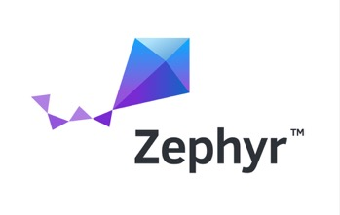

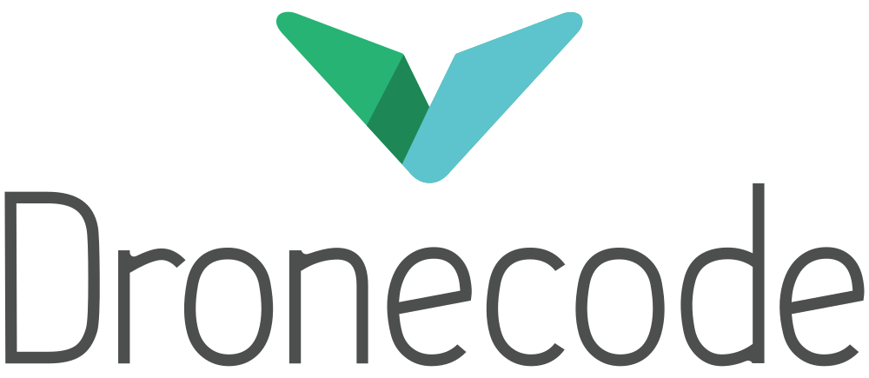


































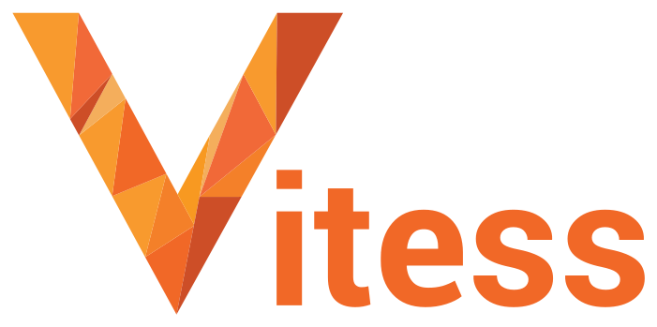













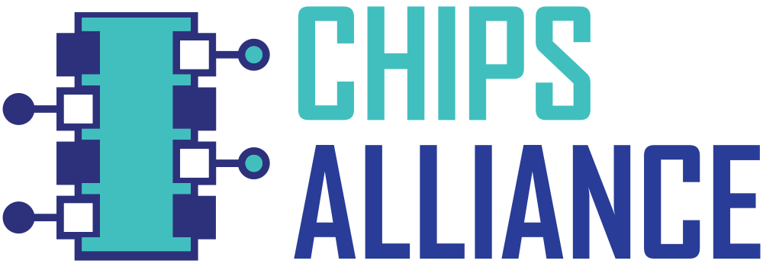








Open Source Projects
Security
Networking
Cloud
Automotive
Blockchain
Edge/IoT
Web
AI
Film
CI/CD
Energy
Hardware
Standards
Notes:
Over time, communities of open source software developers have grown around hundreds of projects in all industries, and categories from hardware to standards, from Energy to Blockchain from Security to AI to Cloud computing.

Slide 7
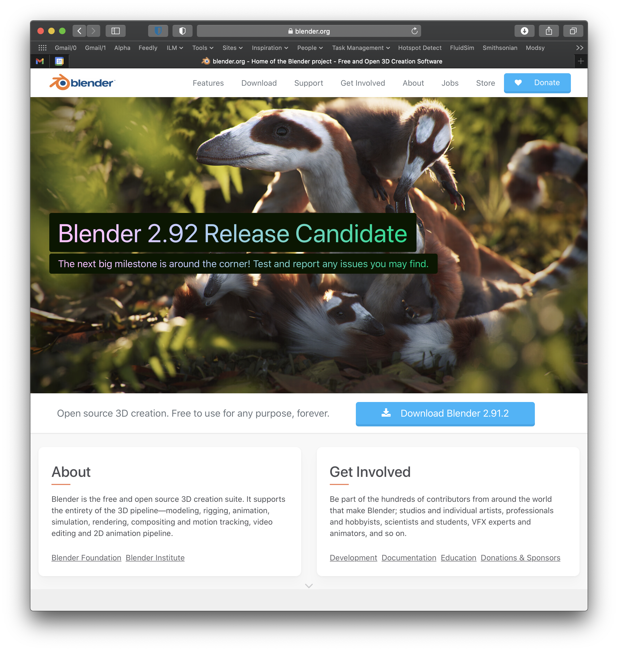
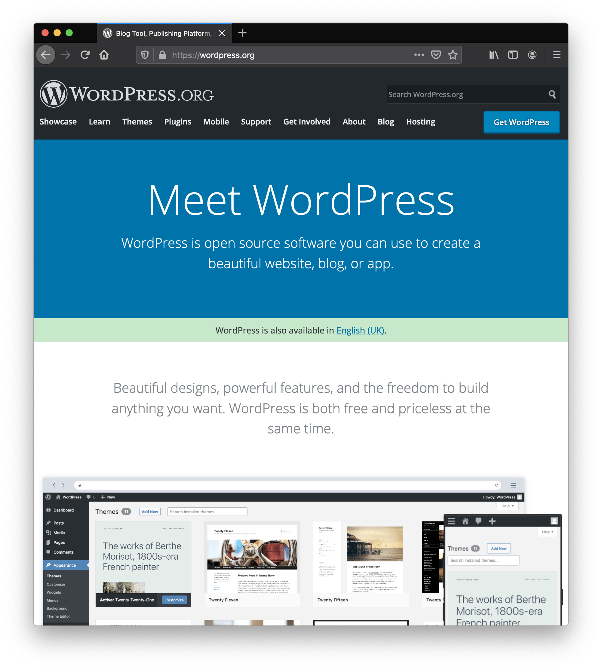
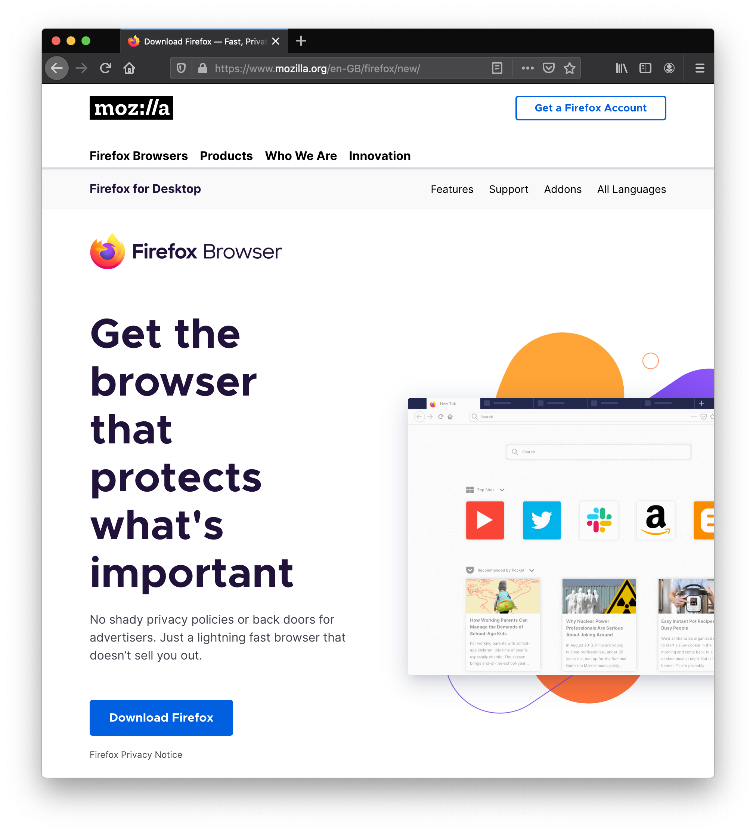
Notes:
And it’s not just libraries and developers tools. Firefox, Blender, Wordpress for instance are great example of end user tools that have a vibrant open source community around them.

Slide 8
Open Source: Innovation Accelerator
Neutral environment for collaboration & cross-pollination
Standardization on open technologies
Innovation multiplier
Enables better interoperability
Minimizes fragmentation
Qualifies reference architectures
Lowers barriers to enter a new domain
Enables new business opportunities
Leads to better products
Allows shared cost of development
Notes:
Open source can really be an enabler for all these things.

Slide 9
About the Academy Software Foundation
Notes:
In that context, why the ASWF, and more particularly what benefits was it set out to bring to the Film industry?

Slide 10
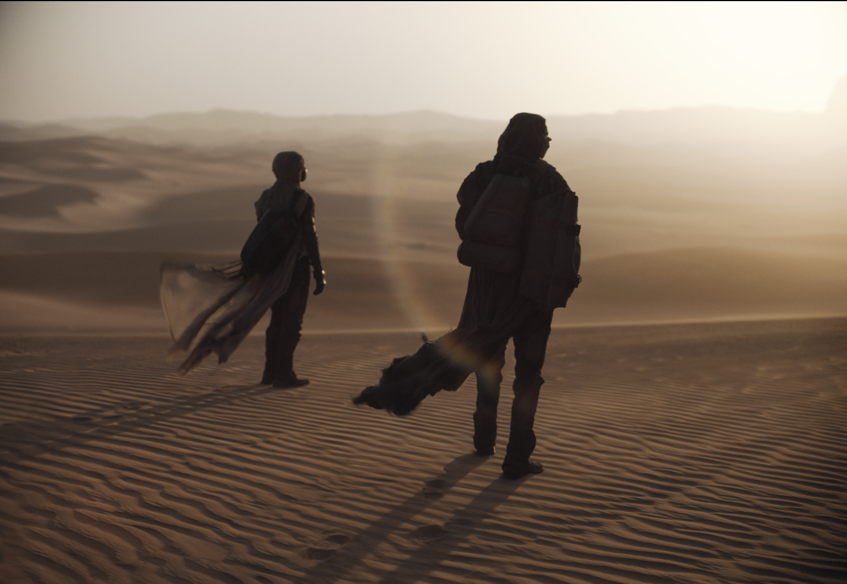

Open Source in Entertainment
How the Academy Software Foundation Creates Shared Value
A report from
Written by
Barbara Robertson
report.aswf.io
DUNE Image Courtesy of DNEG © 2021 Legendary
Warner Bros. Entertainment Inc. All Rights Reserved.
Notes:
Thank you Tim. First I want to talk about our Open Source in Entertainment report that was released yesterday at report.aswf.io. This is the cover - I like this image because it is of a woman and a man, looking into the light, toward a better future, part of a sequence of images, that were transported through OpenEXR, color managed through OpenColorIO, in a movie that has won a few awards and will, probably, maybe, win a few more. We want to thank DNEG and Warner Bros for providing this image, and the many of you who also provided images for the report. We want to thank the many of you who were interviewed for it, and for giving us the benefit of your insight and experience. This document is the first report on Open Source in Entertainment, and it tells the story of open source in our industry, and the history our Foundation: where we came from, what we achieved so far, and where we aim to go next. For people and companies already participating in the Foundation it is a record. For those who are looking at participating, it is a primer. Please read it!

Slide 11


An Open Source Foundation Developed in Partnership
The Academy Software Foundation provides a neutral forum for open source software developers in the motion picture and broader media industries to share resources and collaborate on technologies for image creation, visual effects, animation and sound.
Notes:
The Academy Software Foundation was developed in a partnership between the Academy of Motion Picture Arts and Sciences and the Linux Foundation, both partners bringing a unique blend of film industry knowledge and open source technical and organizational expertise to create a unique organization dedicated to accelerate software development and innovation in the motion picture industry.

Slide 12

Why the Academy Software Foundation?
Legal Framework
Continuous Integration and Build Infrastructure
Clear path to accepting contributions (neutral forum)
Versionitis
Notes:
These were some of the problems that the Foundation set out to solve.

Slide 13


ASWF created
01
Open Source Forum 2022
01
First project
Open Source Day 2019
Open Source Days 2020
Open Source Days 2021
March 10,2022
Rez
DPEL
RawtoACES
August 10, 2018
Founding members:
Animal Logic
Autodesk
Blue Sky Studios
Cisco
DNEG
DreamWorks Animation
Epic Games
Foundry
Google Cloud
Intel
SideFX
The Walt Disney Studios
Weta Digital
Open Source Days 2022
October 23,2018
OpenVDB
New members:
Sony Pictures Entertainment
Warner Bros.
Blender Foundation
Visual Effects Society
July 29, 2019
OpenTimelineIO
Netflix
Amazon Web Services
Rodeo FX
MovieLabs
August 19-20, 2020
Unity Technologies
Conductor Technologies
SMPTE
August 4-5, 2021
MaterialX
Maxon
12
August 8-9, 2022
OpenFX
OpenAssetIO
Open Review Initiative
Canonical
Khronos Group
10
Jan. 28,
2022
Wevr
Sept. 13, 2019
Apple
Microsoft
April 16, 2020
Open Shading
Language
AMD
DockYard
08
Dec. 15,
2020
Adobe
ETC
05
Open Source Forum 2023
February 8, 2019
OpenColorIO
11
13
02
06
09
Feb. 16, 2023
HP
Framestore
03
May 1, 2019
OpenEXR
OpenCue
NVIDIA
ftrack
Red Hat
07
14
Scitech
Council
04
$1M/year
Open source
Investigation
concludes
COVID
19
May
August
Oct
Feb
May
August
Nov
Jan
May
August
Nov
Feb
Nov
Feb
May
Nov
Feb
2018
2019
2020
2021
2022
2023
Notes:
The Academy Software Foundation timeline of notable events since its creation 3 years ago.

Slide 14
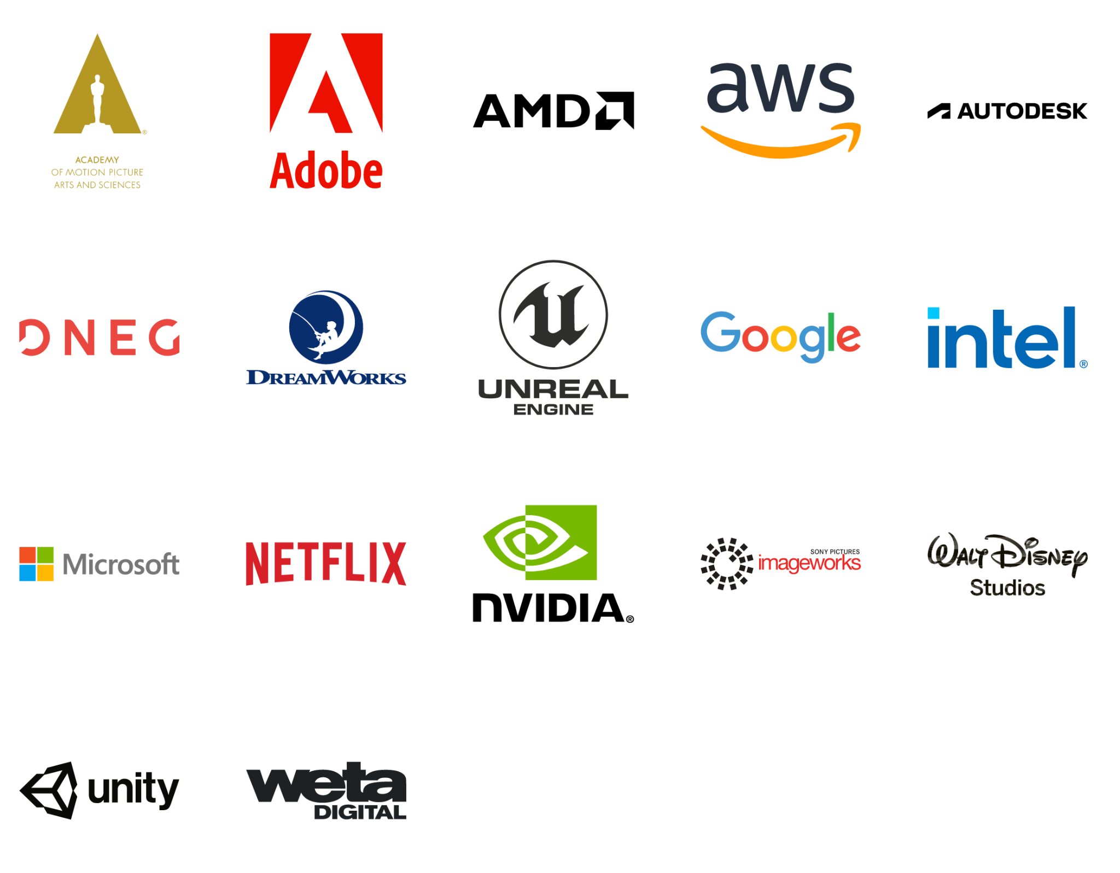
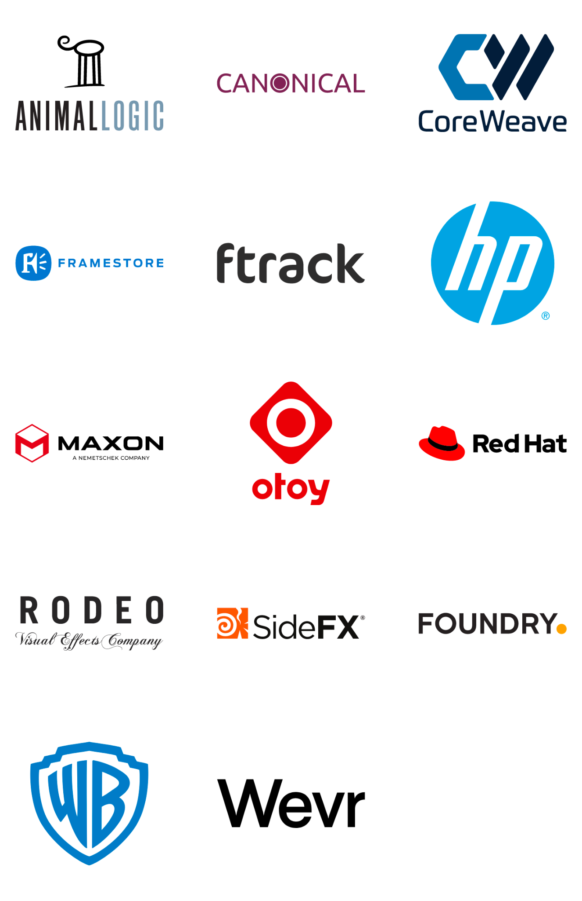
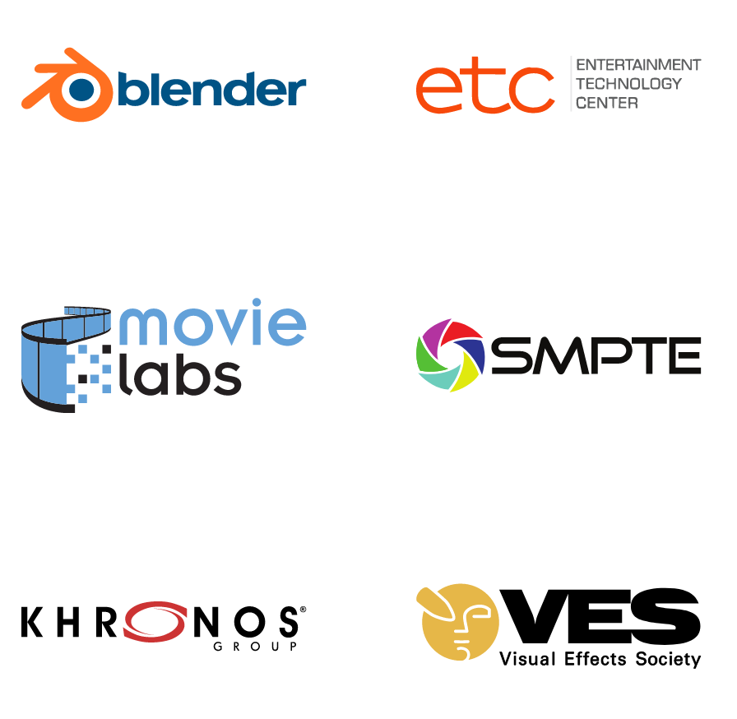
Membership
Premier
General
Associate
Notes:
34 companies

Slide 15
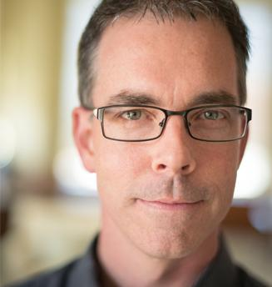
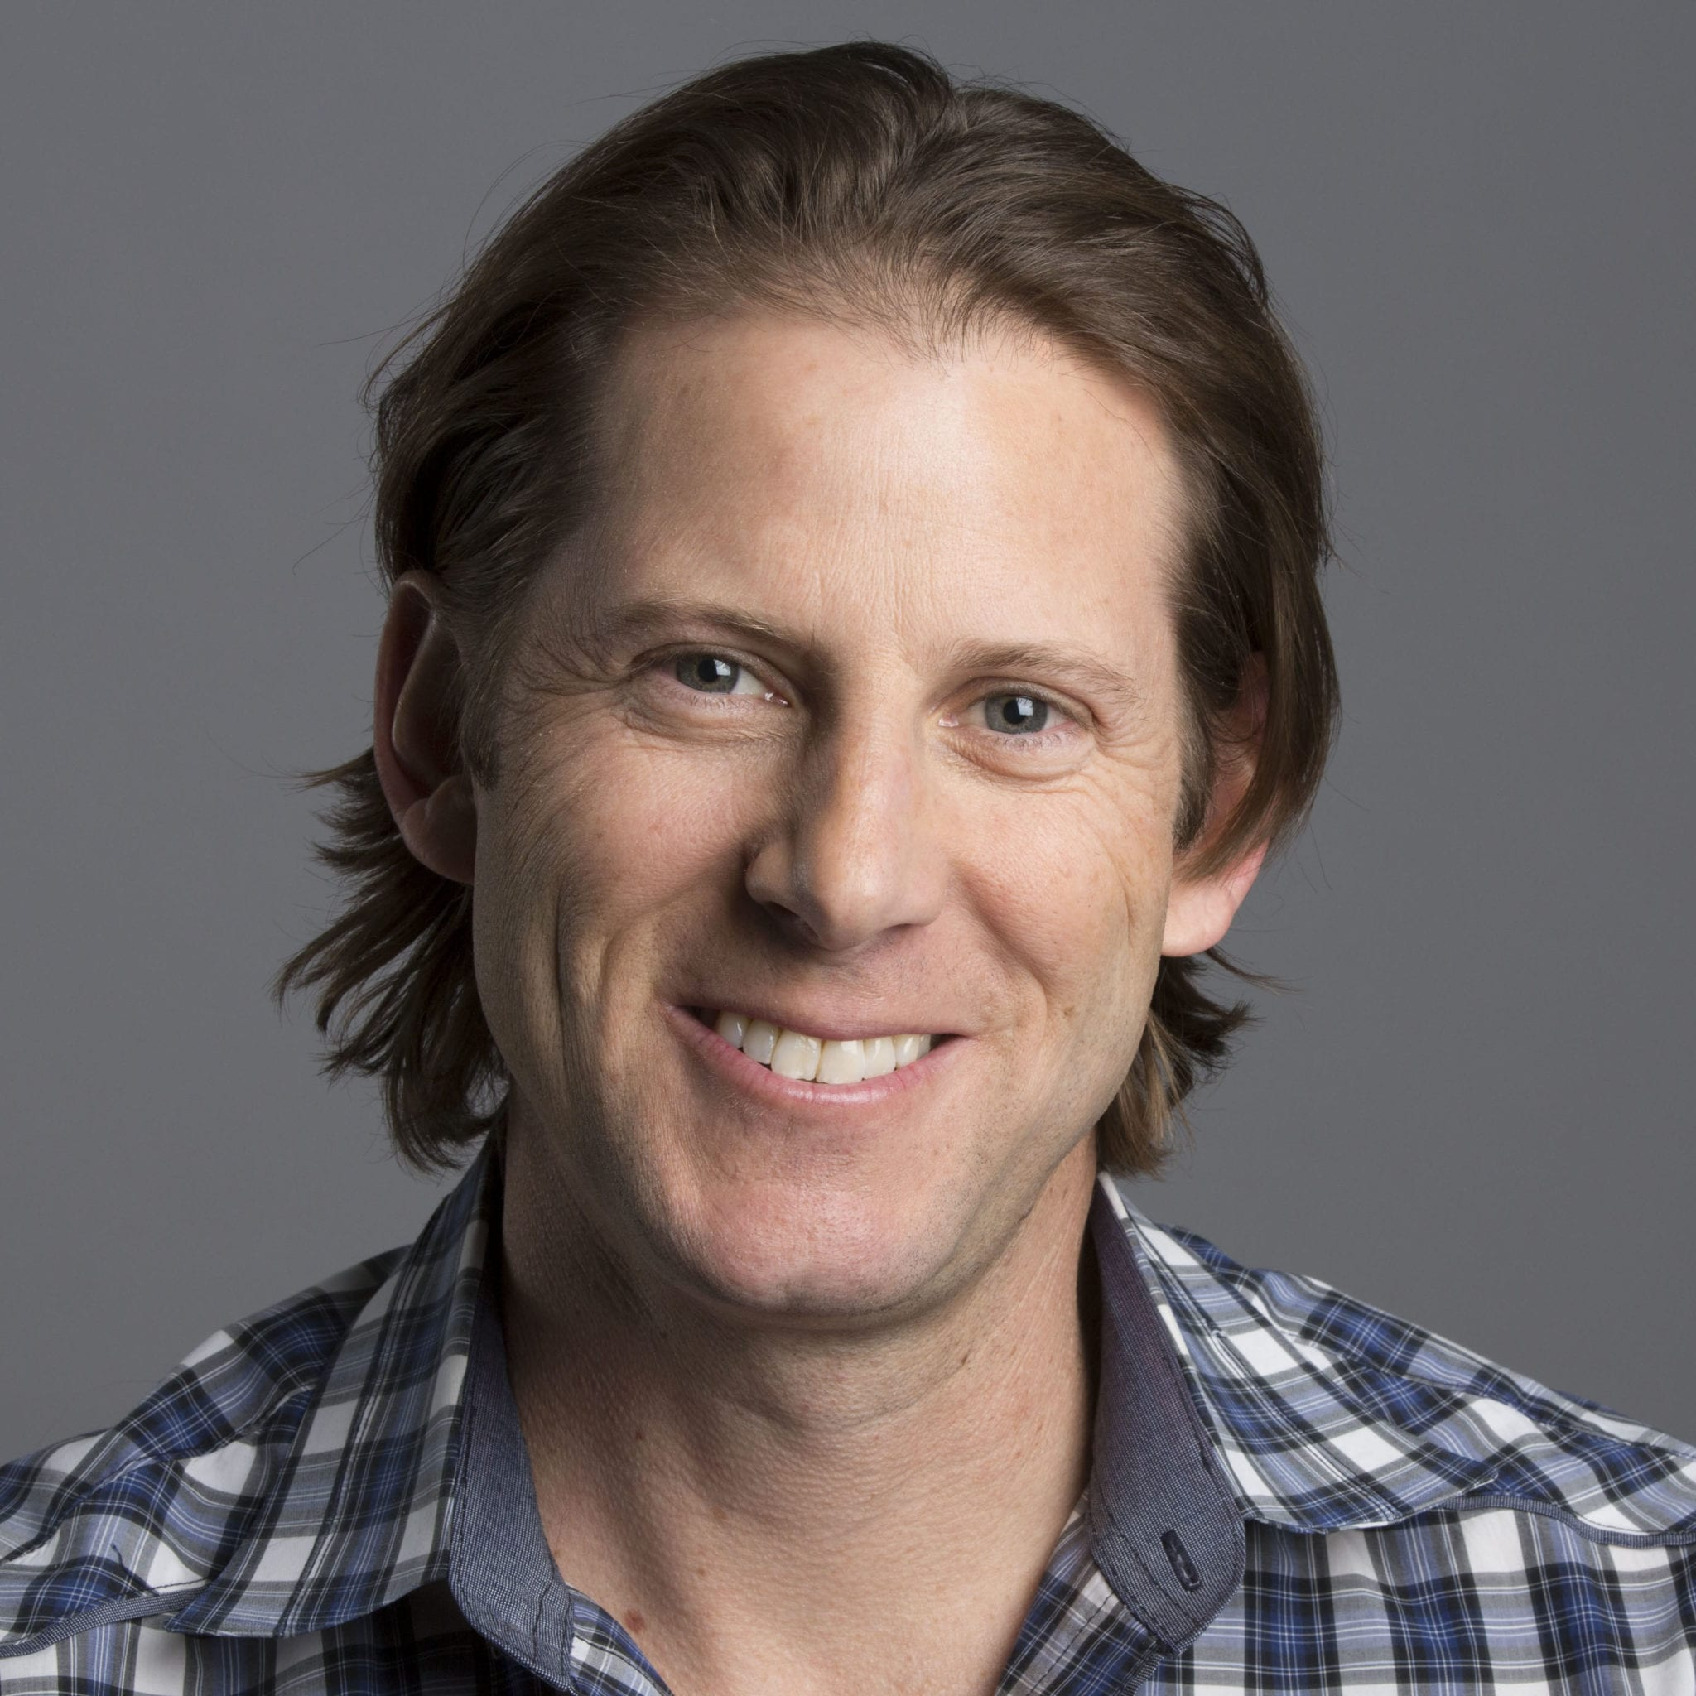
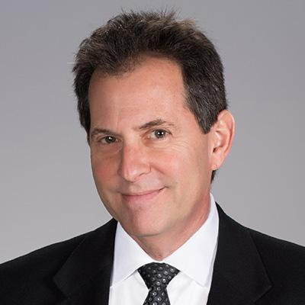

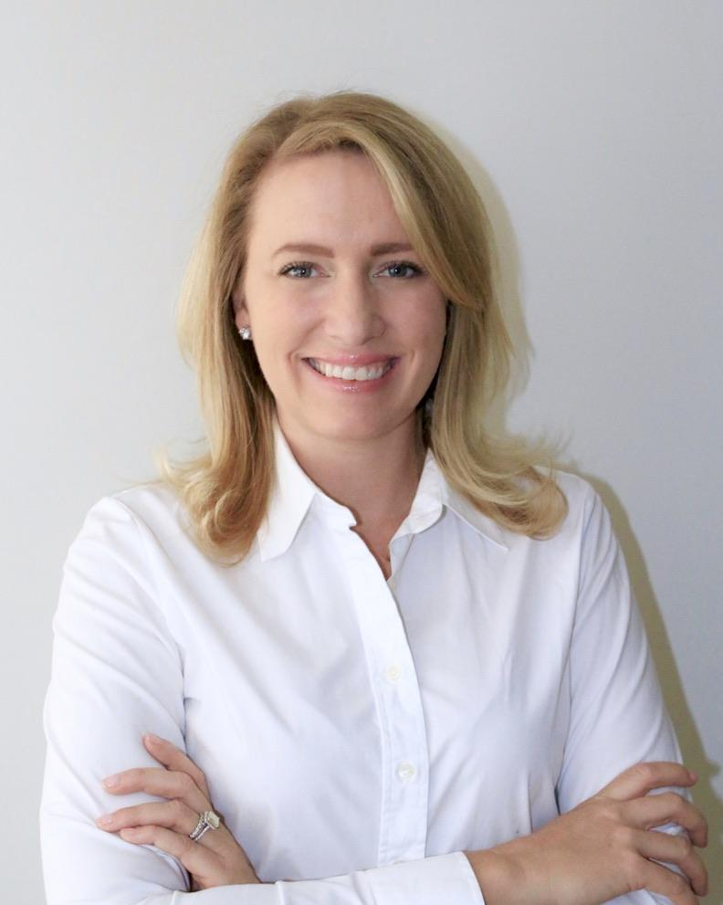
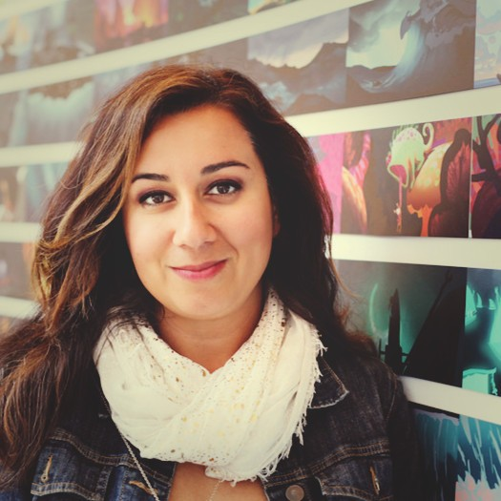
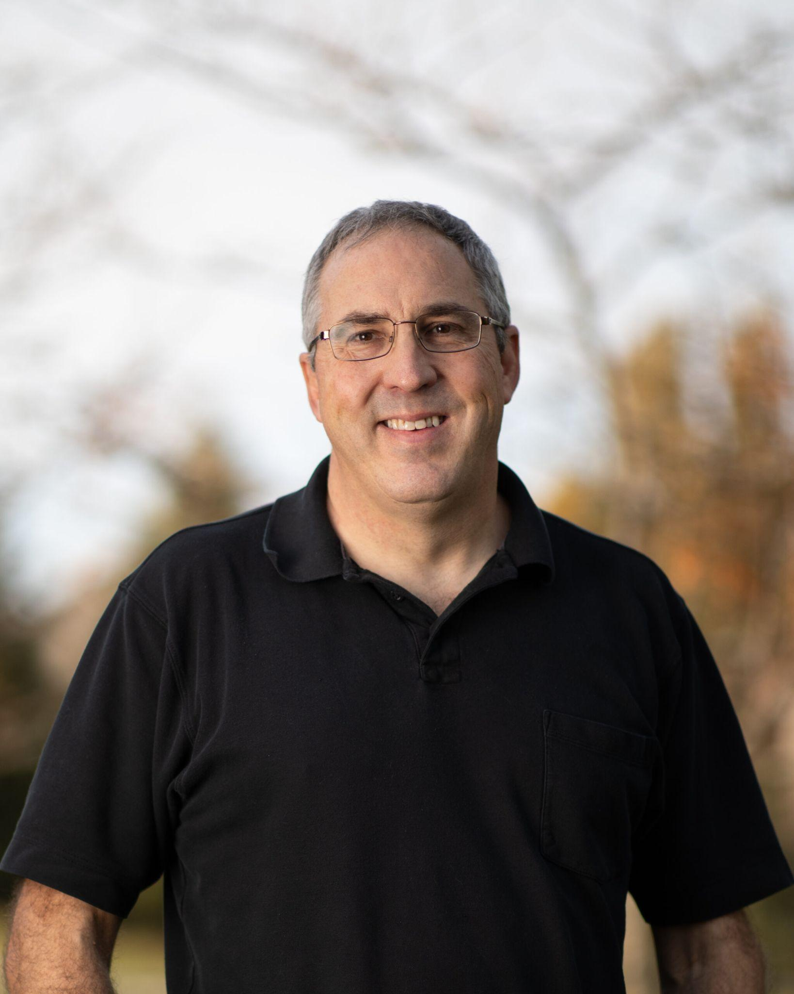
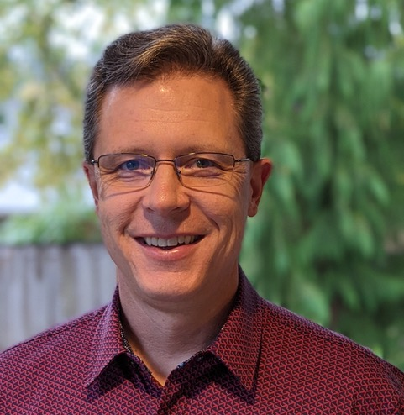
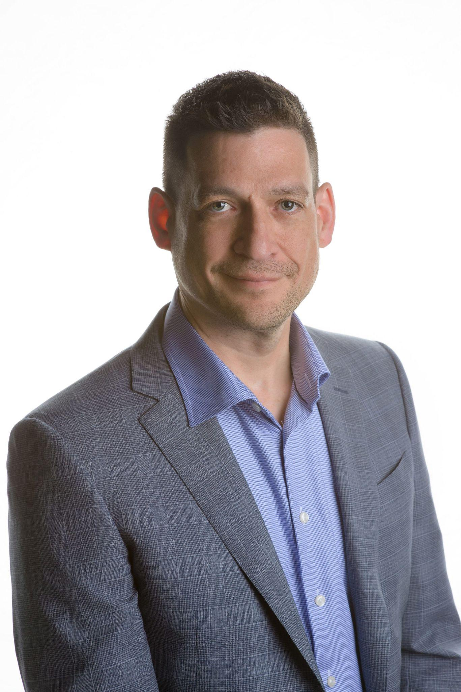
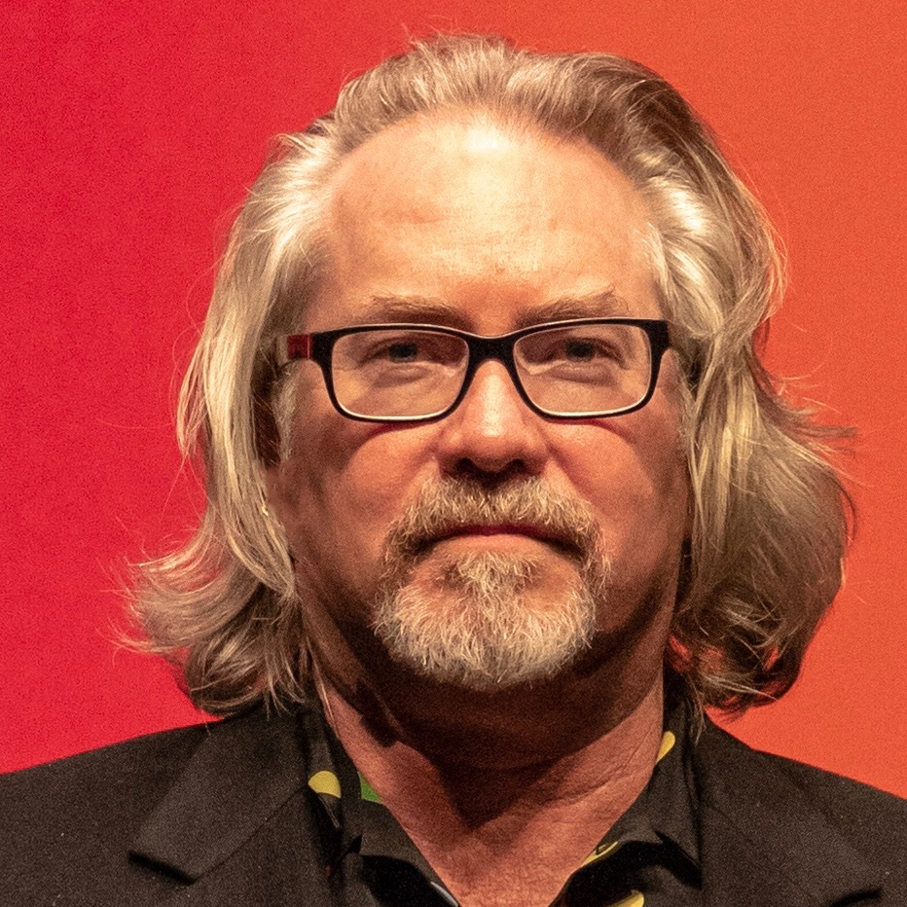
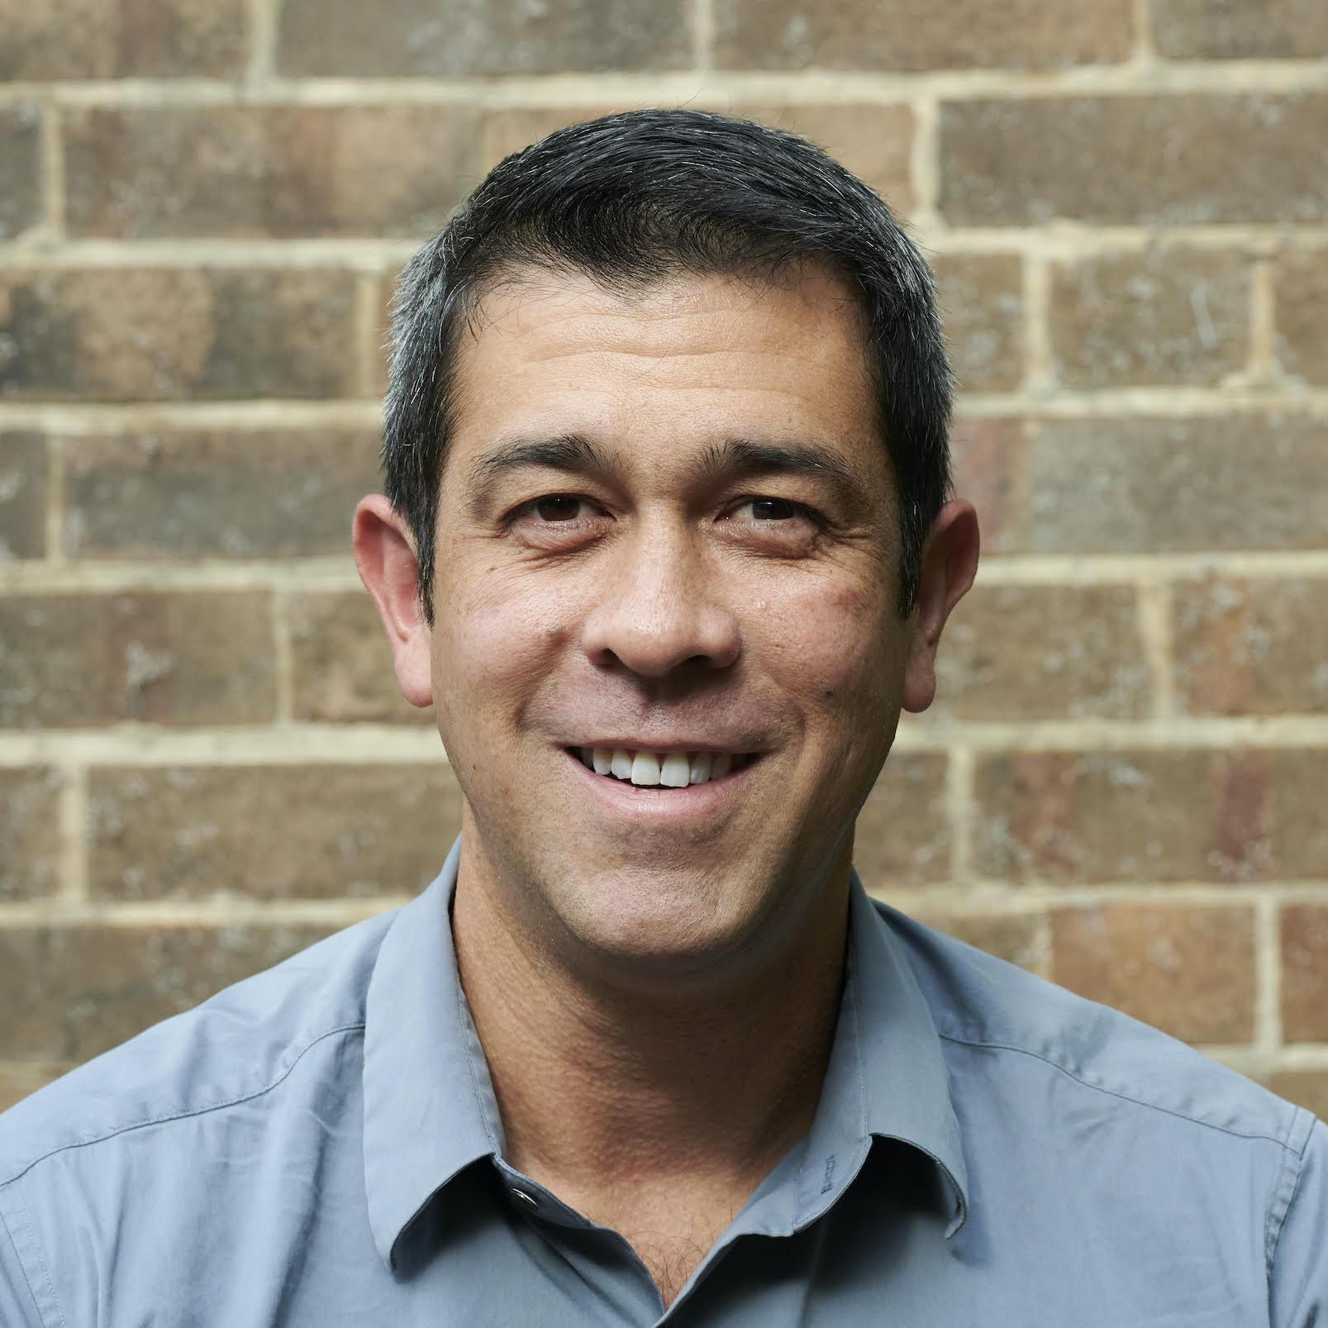
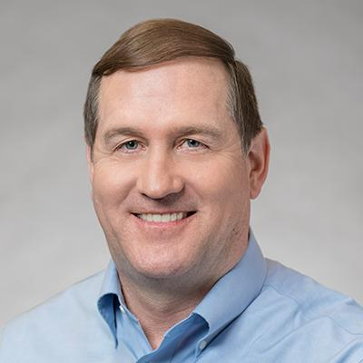
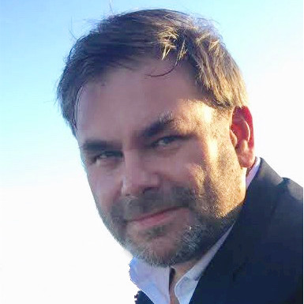
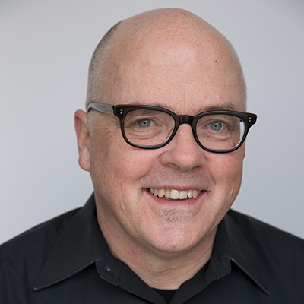

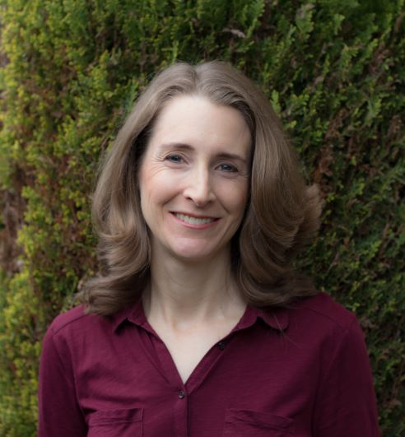
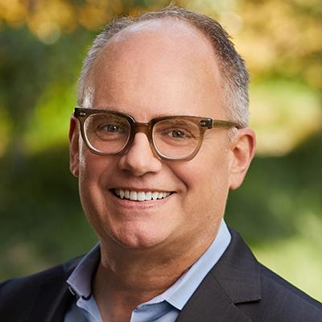
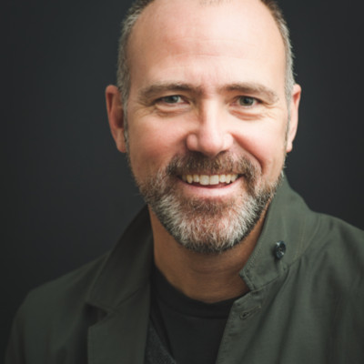

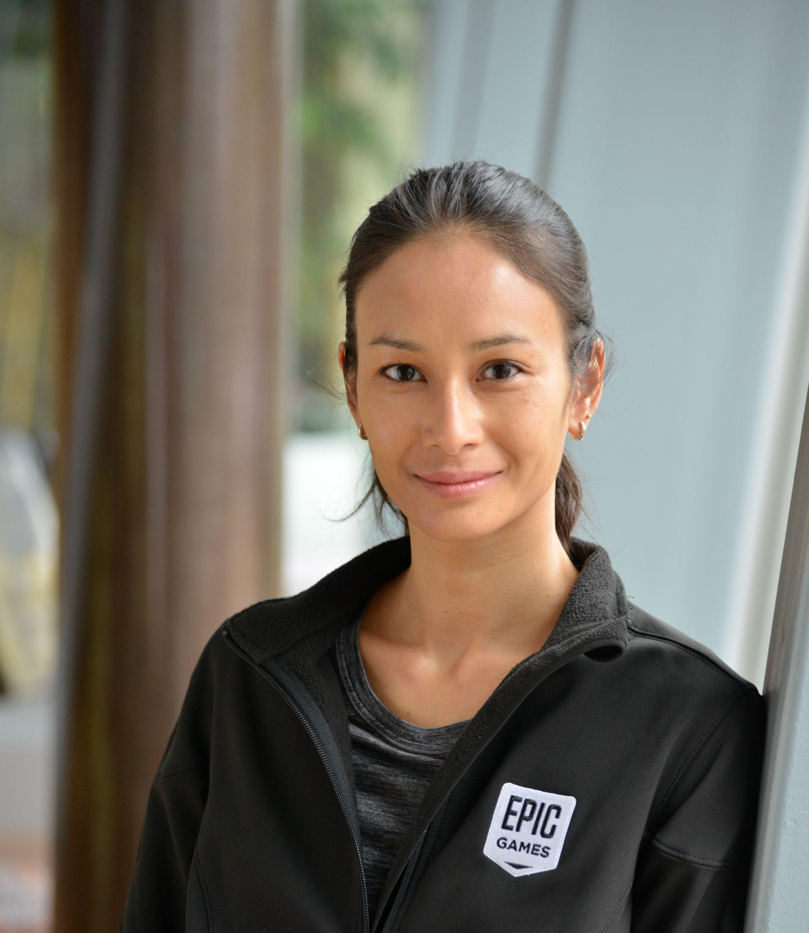
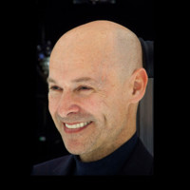

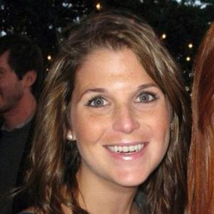
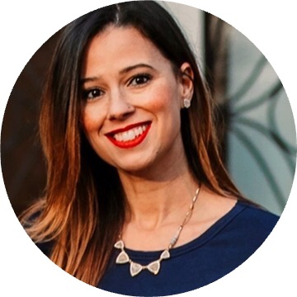
Governing Board
Rob Bredow
Mike Ford
Andy Maltz
Kimball Thurston
Brady Woods
ILM
Sony
Science and Technology Council
Weta
Microsoft
Golriz Fanai
Paul Salvini
Guy Martin
Eric Bourque
Michael Johnson
Darin Grant
Jim Jeffers
Chris Hall
AWS
DNEG
NVIDIA
Autodesk
Apple
Animal Logic
Intel
AMD
Buzz Hays
Bruno Sargeant
Colette Mullenhoff
Andrew Pearce
Bill Roberts
Sebastian Sylwan
Julie Truong
Google Cloud
Unity Technologies
Science and Technology Council
DreamWorks
Adobe
Netflix
Epic Games
Staff
David Morin
John Mertic
Emily Olin
Yarille Kilborn
Epic Games
Linux Foundation
Linux Foundation
Linux Foundation

Slide 16
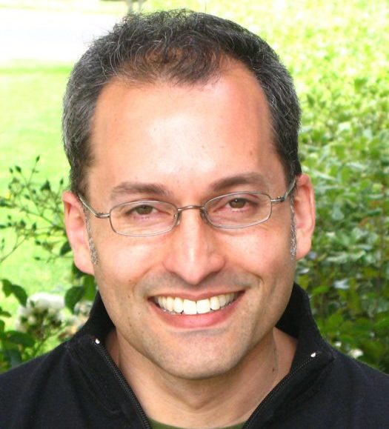
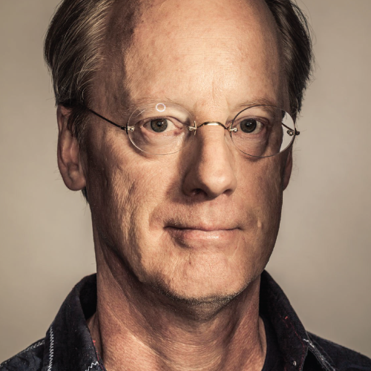

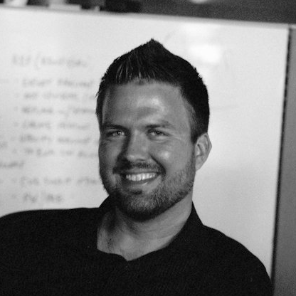
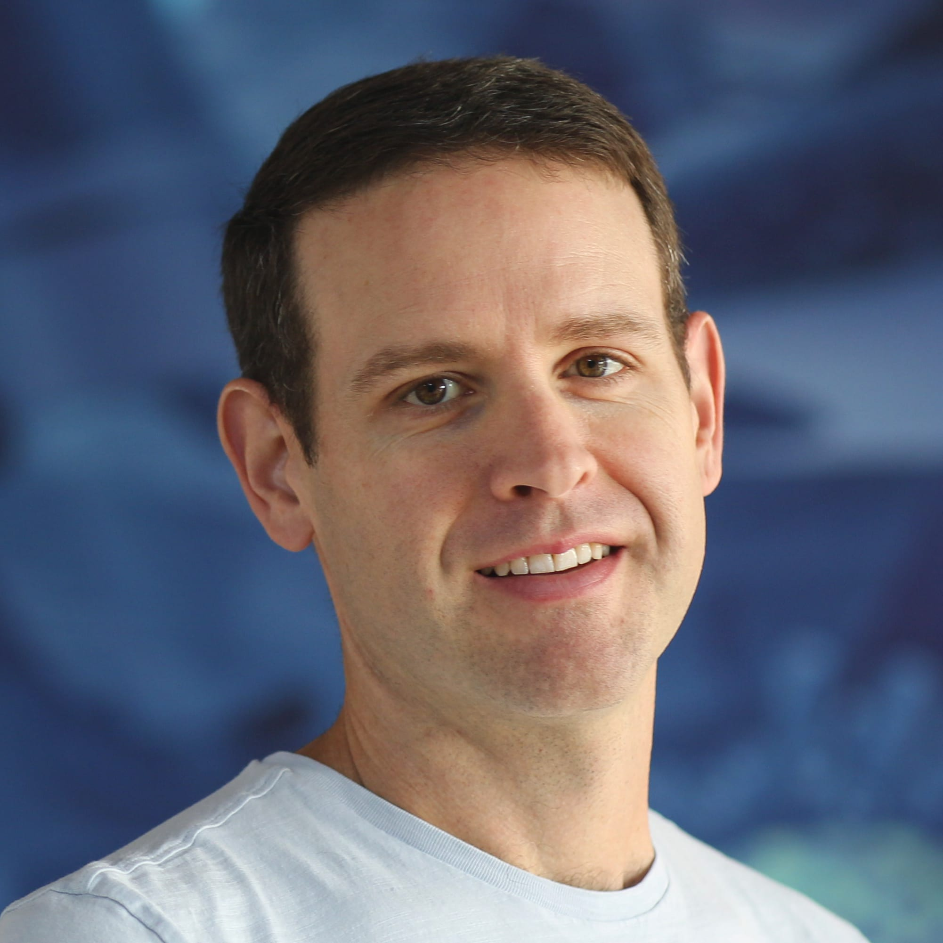
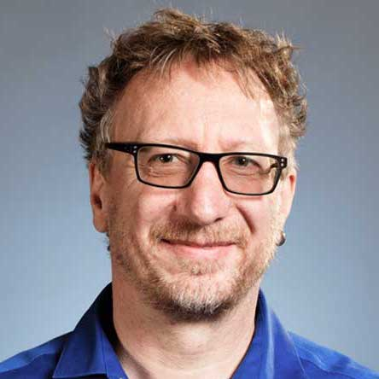

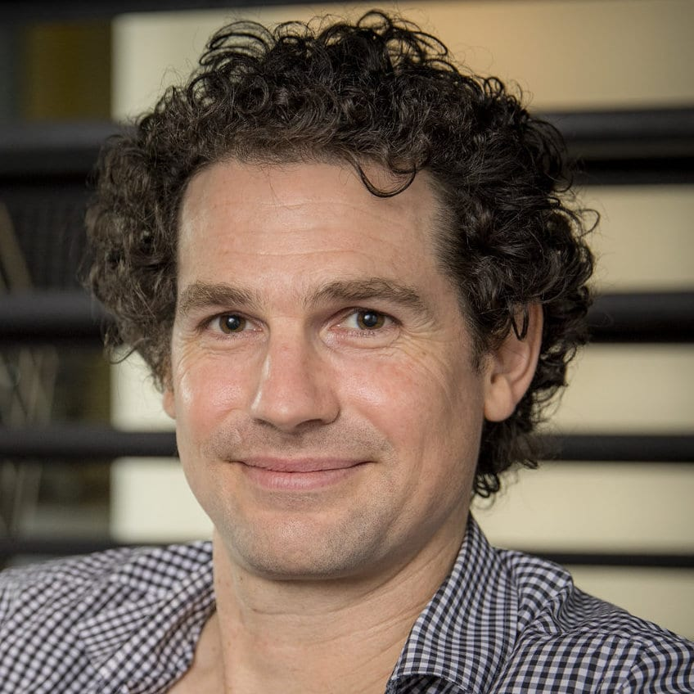
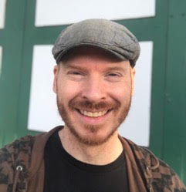



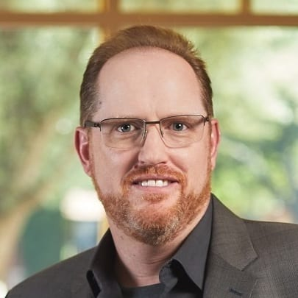
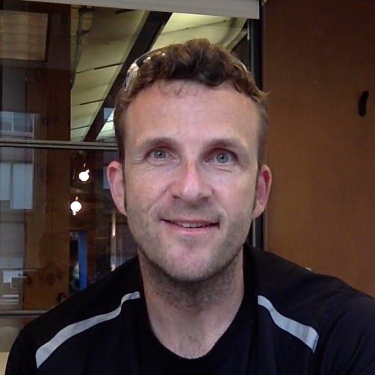

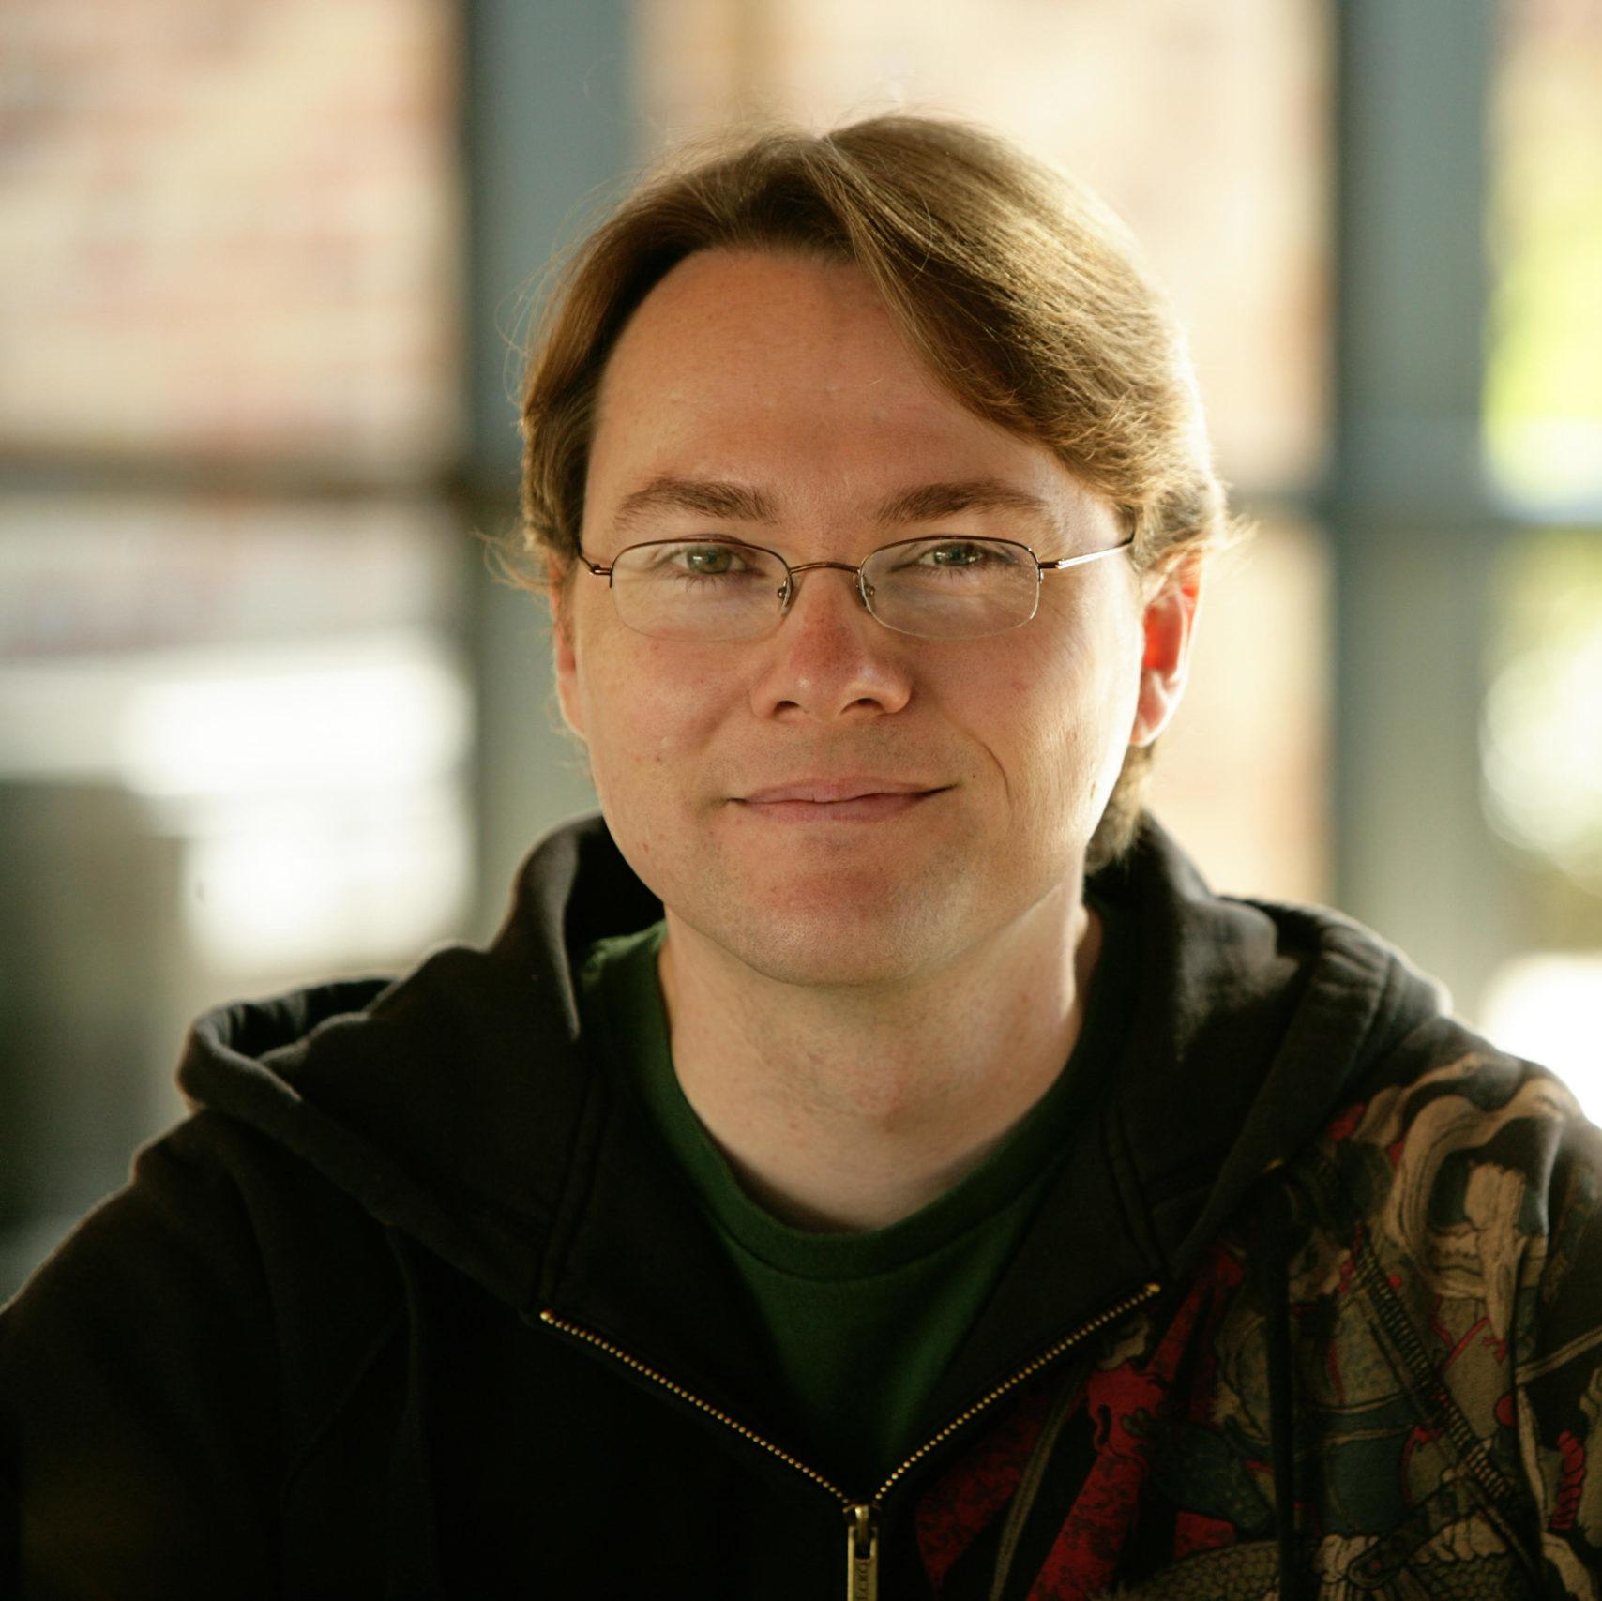

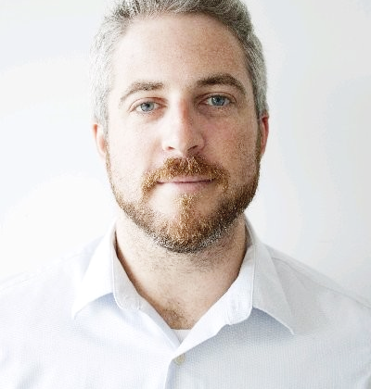
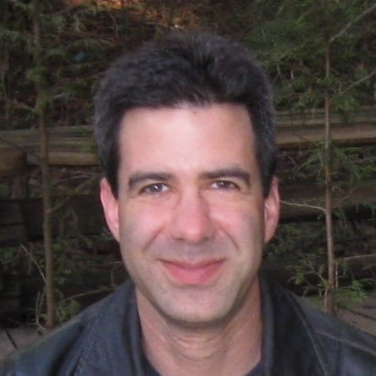
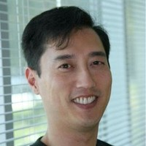
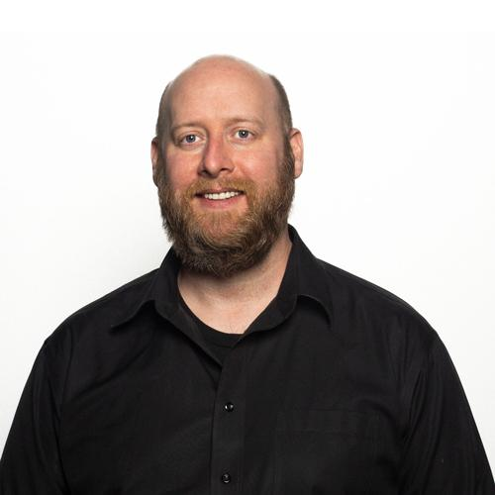
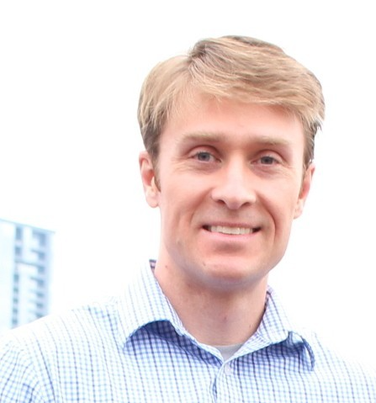
TAC Representatives
Kimball Thurston
Jonathan Stone
Cary Phillips
Christina Tempelaar-Lietz
Weta
Lucasfilm
ILM
Epic Games
Sean Looper
Cory Omand
Ken Museth
Christopher Kulla
Michael Johnson
Daniel Heckenberg
Mark Visser
AWS
Pixar
NVIDA
Epic Games
Apple
Animal Logic
Unity Technologies
Brian Cipriano
Jean-François Panisset
Greg Denton
Bill Ballew
Bill Roberts
Gordon Bradley
Michael Dolan
Google
VES Technologies
Microsoft
DreamWorks
Adobe
Autodesk Inc.
Epic Games
Joshua Minor
Eric Enderton
Sean McDuffee
Larry Gritz
Michael Min
Roy C Anthony
Sean O’Connell
Pixar
NVIDIA
Intel
Sony
Netflix
DNEG
Advanced Micro Devices

Slide 17
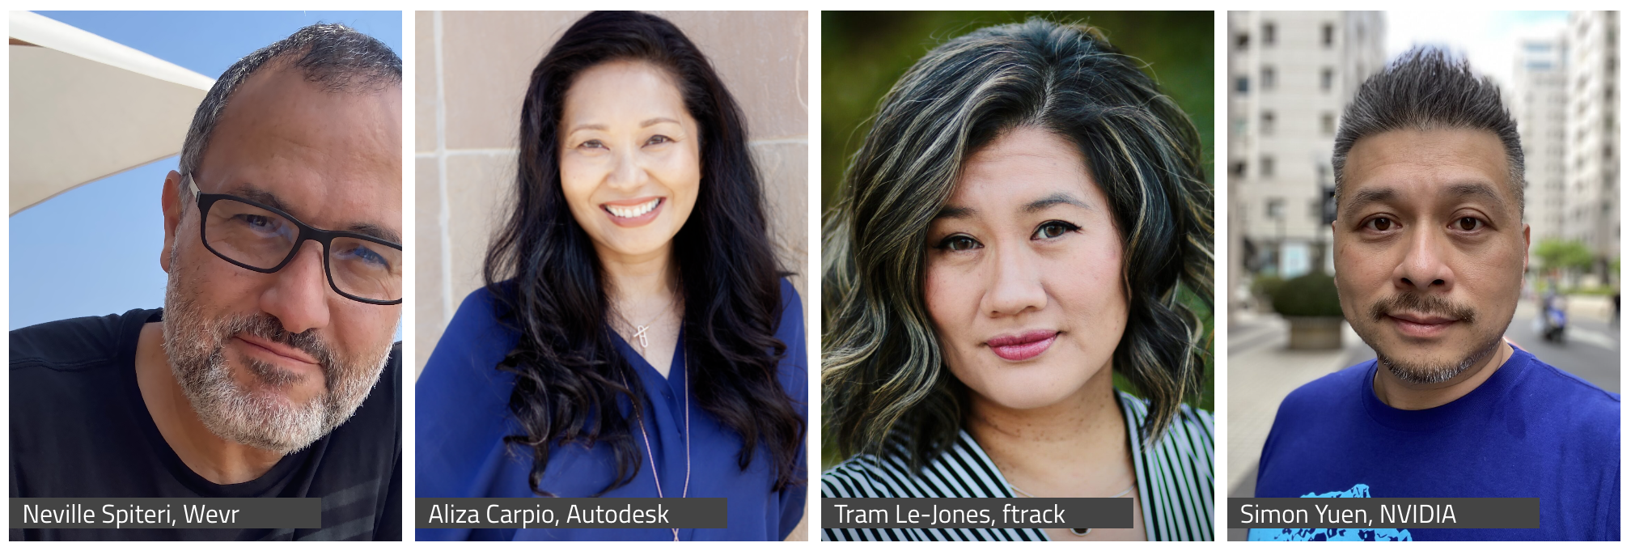
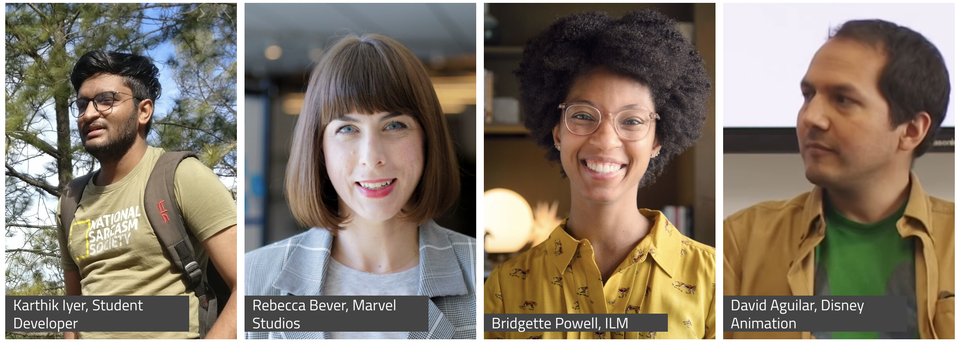
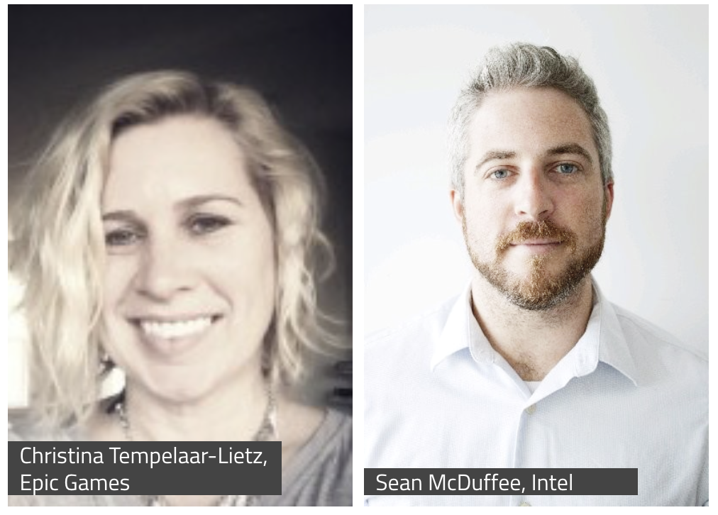
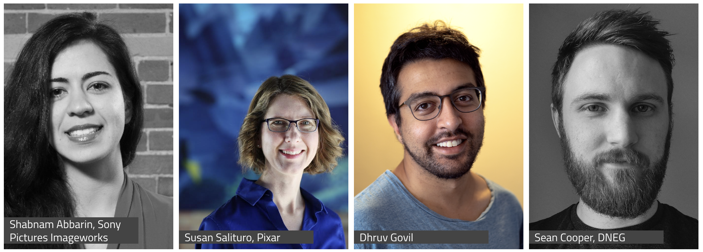





Behind the Screens
Notes:
We appreciate the community’s involvement in the Behind the Screens series, it’s something we really enjoy doing and the content performs well. We plan to introduce video series for BTS and Project Spotlights this year.

Slide 18
Our Mission
Increase the quality and quantity of open source contributions by establishing a governance model, a legal framework and a community infrastructure that lowers the barrier to entry for developing and using open source software.

Slide 19
Our Goals
Provide a neutral forum to coordinate cross-project efforts, establish best practices and share resources.
Develop an open continuous integration (CI) and build infrastructure to enable reference builds from the community.
Streamline development for build and runtime environments through the sharing of open source build configurations, scripts and recipes.
Provide individuals and organizations with a clear path for participation and code contribution.
Provide better, more consistent licensing through a shared licensing template.
Create working groups for exploration of new or larger projects.
Focus on diversity and inclusion and raising the profile of software engineers in our industry.

Slide 20













Our Projects
contributed by:
Dreamworks Animation
contributed by:
Google Cloud and
Sony Pictures Imageworks
contributed by:
The Academy of Motion Picture Arts and Sciences
contributed by:
Sony Pictures Imageworks
contributed by:
Lucasfilm
contributed by:
Pixar Animation Studios
contributed by:
Sony Pictures Imageworks
contributed by:
Lucasfilm
contributed by:
Allan Johns
created by:
Academy Software Foundation
contributed by:
Open Effects Association
contributed by:
Foundry
created by:
Academy Software Foundation

Slide 21
Diversity & Inclusion
Diversity & Inclusion Working Group
“Open source has the power to break down racial, gender, and corporate barriers to unite people around a shared goal…”
Read more at aswf.io/diversity_inclusion.

Slide 22

ASWF Landscape
l.aswf.io
Public list of open source projects in the animation and VFX industry
Updates can be submitted via GitHub
Goal is to have all active, open source projects in animation and VFX industries represented.

Slide 23





Structure
TAC
Technical Advisory Council
Governing Board
Outreach Committee
rawtoaces
Continuous Integration platform
Notes:
13 projects!

Slide 24


How to Train Your Dragon: The Hidden World; courtesy of DreamWorks Animation
The Croods; courtesy of DreamWorks Animation
First project adopted by ASWF in Sept. 2018; first project to graduate to adopted status in July 2019.
Developed by DreamWorks Animation in 2012.
C++ library for volumetric representations including fluid simulations, animated volumes and environmental effects.
Academy Technical Achievement Award recipient.
Key contributors include DreamWorks, Autodesk, DNEG, Industrial Light & Magic, NVIDIA, SideFX, Weta Digital.
openvdb.org
Notes:
Used on films including Boss Baby, Trolls, The Croods, and How to Train Your Dragon: The Hidden World
Since joining:
Released v6.0, v6.1, v7.0 (above + bug-fixes & optimizations)
New collaborations (Autodesk/Nvidia)

Slide 25



Nuke
Spider-Man™: Into the Spider-Verse; all images courtesy of Imageworks
Joined ASWF in Feb. 2019; adopted status in Nov. 2019.
Developed by Sony Pictures Imageworks in 2003.
Provides a consistent user experience across digital content creation applications; widely adopted in VFX and computer animation studios and software.
Academy Technical Achievement Award recipient.
Key contributors include Imageworks, Autodesk, DNEG, ILM, Foundry, Framestore.
OCIO v2 released fall 2020, led by Autodesk.
Katana
opencolorio.org
Notes:
Top image is in Foundry’s Nuke, bottom in Foundry’s Katana

Slide 26


Smurfs: The Lost Village; courtesy of Sony Pictures Imageworks
OpenCue screenshot
Joined ASWF in April 2019.
Developed at Sony Pictures Imageworks as its internal render farm manager (“Cue3”); collaboration with Google Cloud to release as OpenCue in January 2019.
Fully featured render manager for media and entertainment that can be used to break down complex jobs into individual tasks.
Contributors include Imageworks, Google, Netflix, Microsoft, Amazon.
Monthly releases over the past year, including adding Python 3 compatibility, Windows support, new documentation.
opencue.io

Slide 27


Images from Solo: A Star Wars Story. © and TM Lucasfilm Ltd. All Rights Reserved.
Joined ASWF in April 2019; adopted status in Nov. 2019.
Developed by ILM in 1999; first release of a major open source project by a studio.
High dynamic-range (HDR) image file format for high-quality image processing and storage; widely adopted standard in computer graphics.
Academy Technical Achievement Award recipient.
Key contributors include ILM, Disney Animation, Imageworks, Epic Games, Weta Digital, Pixar, Autodesk, and DreamWorks.
OpenEXR 3.0 just released.
openexr.org

Slide 28

OpenTimelineIO used on Coco for transitions and linking media to the latest renders.
Image courtesy of Pixar Animation Studios.
Joined ASWF in July 2019.
Developed by Pixar Animation Studios.
Open source interchange format for editorial timeline information – clips, timing, tracks, transitions, metadata etc.
Key contributors include Pixar, Netflix, DreamWorks, Autodesk.
In Public Beta
opentimeline.io

Slide 29


The Angry Birds Movie 2; courtesy of Imageworks
Spider-Man: Far From Home; courtesy of Imageworks
Joined ASWF in April 2020.
Developed by Sony Pictures Imageworks; released as open source in 2010.
De facto standard shading language for VFX and animation, ideal for describing materials, lights, displacement, and pattern generation.
Academy Technical Achievement Award recipient.
Key contributors include Imageworks, Animal Logic, NVIDIA, Pixar, DNEG, Autodesk.
openshadinglanguage.org

Slide 30

ILM Production tests using MaterialX
Joined ASWF in March 2021.
Open standard for representing rich material and look-development content in computer graphics, enabling its platform-independent description and exchange across applications and renderers.
Launched at Industrial Light & Magic in 2012, MaterialX has been a key technology in their feature films and real-time experiences since Star Wars: The Force Awakens and Millennium Falcon: Smugglers Run.
Key contributors include Sony Pictures Imageworks, Pixar, Autodesk, Adobe, and SideFX.
materialx.org

Slide 31



Typical package managers install packages into an environment
Rez installs packages once, and configures environments dynamically
Joined ASWF in February 2022.
Developed by Allan Johns of Method Studios.
Cross-platform package manager that leverages a central repository for storing packages instead of installing into each environment separately, reducing the time to create complex environments to just a few seconds.
Key contributors include Luma Pictures, Method Studios, NVIDIA, and Shotgrid
rez-project.io

Slide 32
New Api
Spectral
Repo
Metadata
Update writing
Lens Functions
HDRI Merging
Bindings
December 2022
Joined ASWF in January 2021.
Software package that converts digital camera raw files to ACES container files containing image data encoded according to the Academy Color Encoding Specification (ACES) as specified in SMPTE 2065-1.
Key contributors include AMPAS and Weta Digital
rawtoaces.org

Slide 33

OpenFX Overlay Draw Suite
Industry-wide common interface between image-based visual effects plugins and host applications, used by Autodesk Flame, Foundry Nuke, Blackmagic Design DaVinci Resolve and Fusion, Sony Catalyst and MAGIX Vegas Pro, Assimilate Scratch, Filmlight Baselight, Boris FX Sapphire and Silhouette, RE:Vision Effects and more. Open, extensible C API currently version 1.4 with version 1.5 in development. Want to find out more or contribute?
openeffects.org

Slide 34




Launching with ASC Standard Evaluation Material II (StEM2), Animal Logic’s ALab Phase 2, Intel’s Volumetric Clouds Library and AWS character Noa.
Providing a vendor-neutral hosting platform and a uniform license agreement, to encourage, curate and publish production-grade sample assets for developers, researchers and educators, Digital Production Example Library is the conclusion of an Academy Software Foundation working group on assets
dpel.aswf.io

Slide 35
















OpenAssetIO is an early stage open source interoperability standard between tools and asset management systems, developed by Foundry with proofs of concept and design input from 15 companies including DNEG, Pixar, Amazon Web Services, Animal Logic, Blizzard, and Blender. OpenAssetIO was the first project to join the Academy Software Foundation in sandbox stage.
openassetio.org

Slide 36


Autodesk’s RV Player
DNEG’s xSTUDIO
A new open source project with the mission to build a unified toolset for playback, review and approval of motion picture and related professional media, with Autodesk contributing RV, Dneg contributing xSTUDIO, Imageworks contributing parts of itView, and the three companies providing lead architects and maintainers for the project Technical Steering Committee.
openreviewinitiative.org

Slide 37
Working Groups
CI
Diversity and Inclusion
Rust
USD

Slide 38

How to contribute
Contribute to an existing project:
Submit a PR with a bugfix or new feature
Pick existing GitHub issue as a sample project
Integrate with a new app / contribute plugin
Help improve project documentation
Submit additional test cases
Join the TSC discussion: dev mailing list, conf calls
Get involved with the TAC or Working Group:
DevOps / CI expertise always useful
Interest / expertise in security especially welcome
Join the TAC discussions: mailing list, conf calls, working groups
More information at tac.aswf.io/engagement

Slide 39
Join the Discussion
Mailing Lists for ASWF projects: lists.aswf.io
Join as a member: aswf.io/join
Slack: slack.aswf.io
Github: github.com/AcademySoftwareFoundation
Behind the Screens: bit.ly/BehindtheScreens
Twitter: @AcademySWF, #ASWF
YouTube: AcademySoftwareFoundation

Slide 40
How to participate
Developers can join our mailing lists to stay informed
about the code and our projects at lists.aswf.io.
Learn how your organization can support the Academy Software Foundation community at aswf.io/join.
Stay connected to us on Twitter at
@AcademySWF and #ASWF

Slide 41


